Slide 1

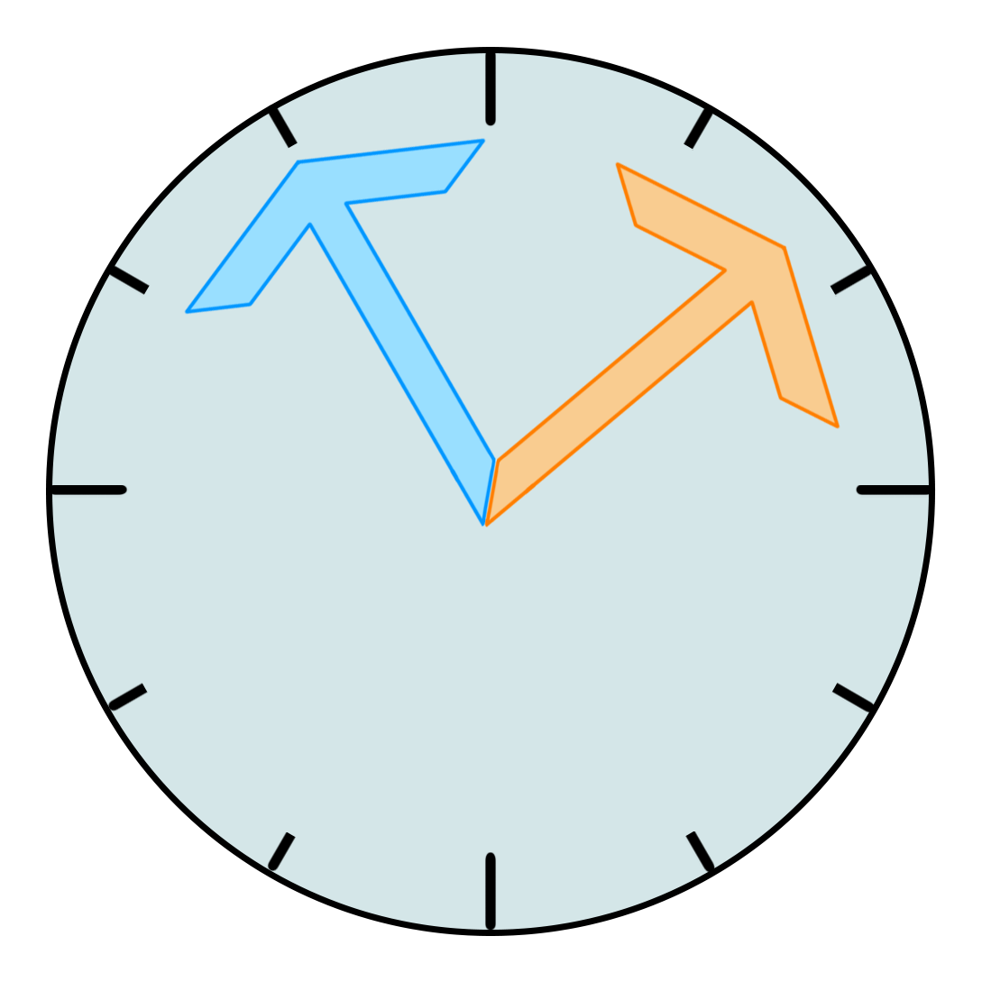
Time Tested
Avital Gordin & Itay Bernstein

Slide 2
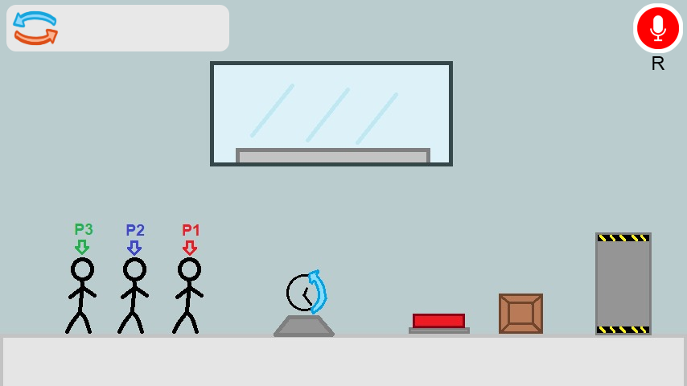
Game Concept Art

Slide 3
The Idea
Tools used:
Cooperation between players
Puzzles to solve
Enemies to defeat
Testing powerups
Unity Game Developing Engine
Photon Multiplayer Framework (PUN-2 API)
Deepgram API

